Slide 1
CMOS process flow

Slide 2
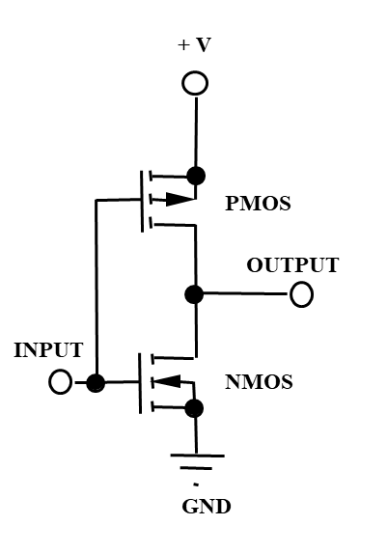
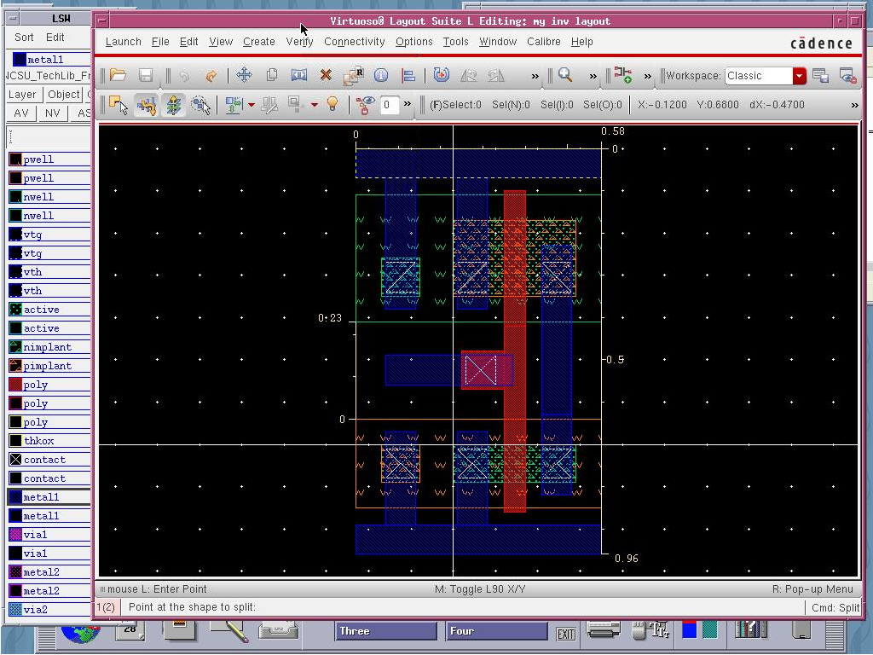
Outline
We will go through the process flow to create a simple inverter
We will use ~80 process steps and 13 masks*
The process flow will be significantly simplified
No need to understand all the details
ECE429 Lab3 - Tutorial II: Inverter Layout (iit.edu)

Slide 3
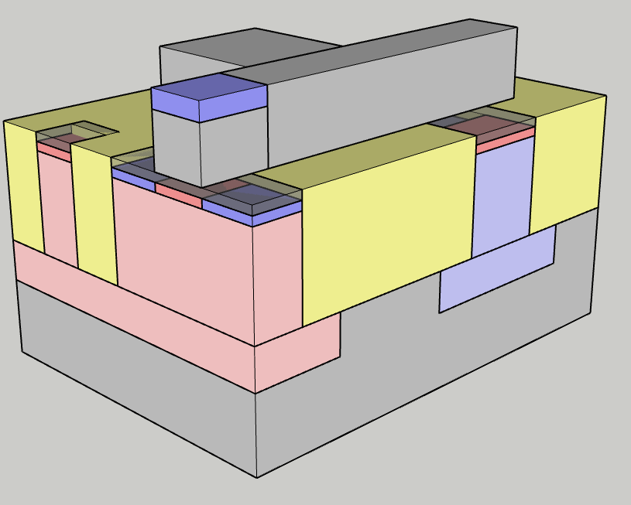
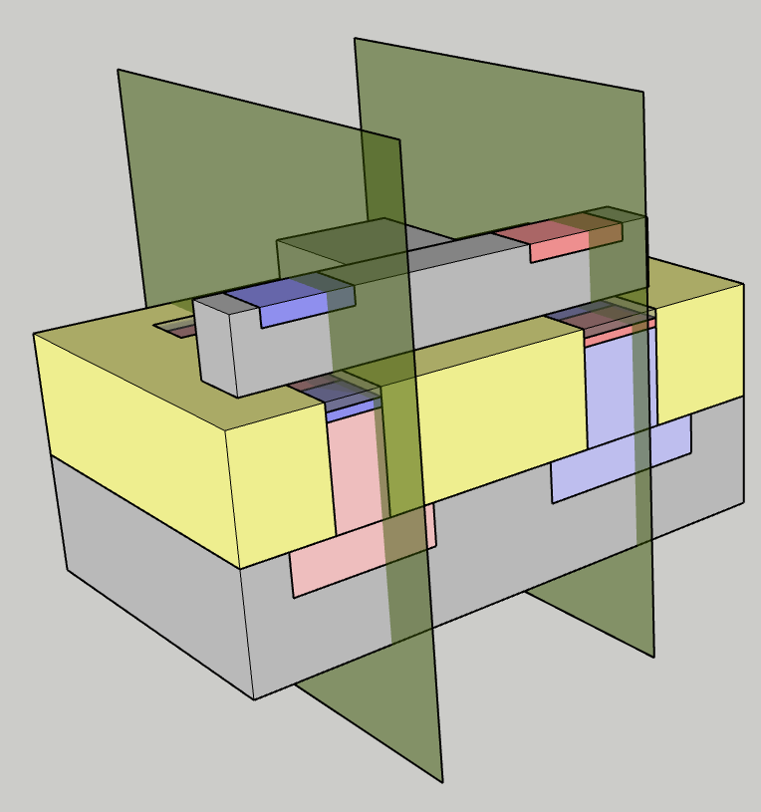
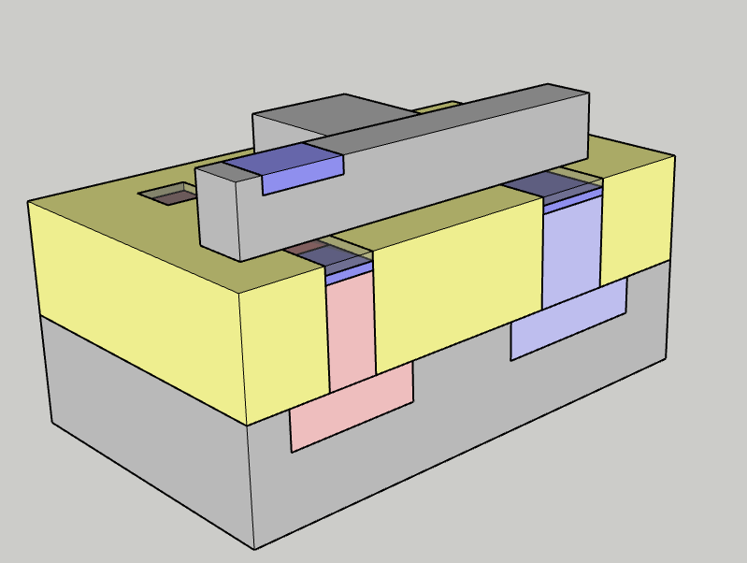
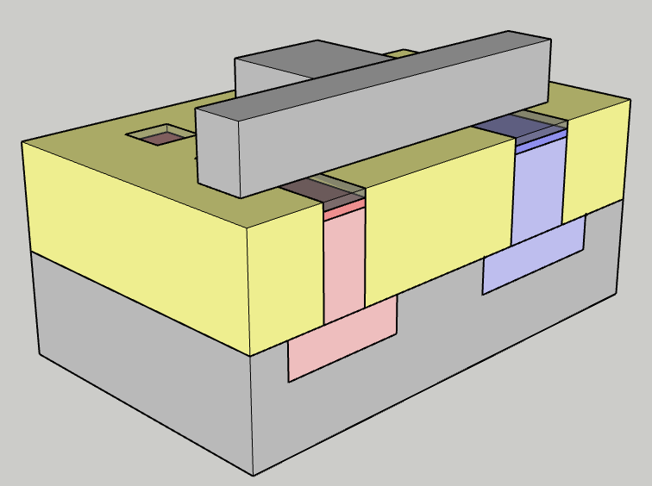
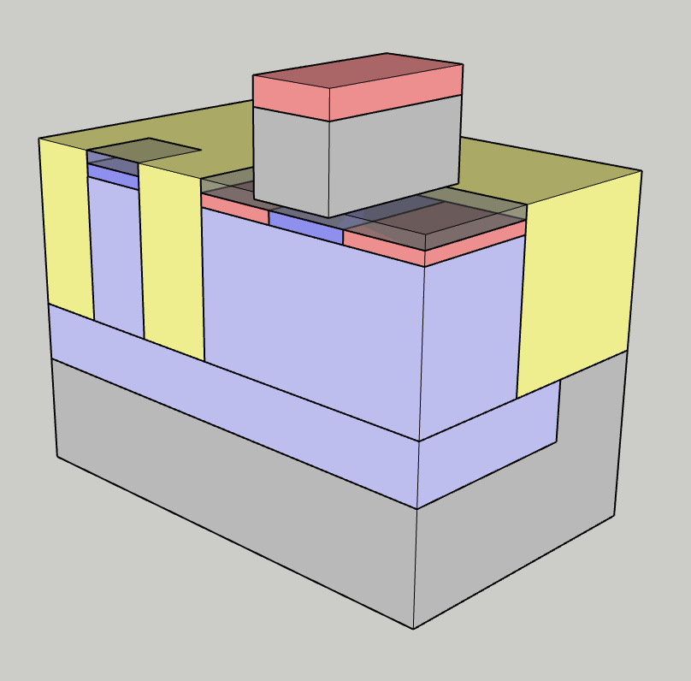
Process flow slide structure
Mask counter
Mask counter: 6
n-channel MOS cross section
n-LDD implant
Resist strip
Photo-resist spinning
Mask 6 exposure (p-LDD)
p-LDD implant
Resist stripping
Spacer dielectric deposition
Process steps list (traveler)
3D view of the integrated circuit
p-channel MOS cross section
Photo-resist is removed:
  O2 downstream plasma (no ion bombardment)
  Wet etching (e.g. H2SO4+H2O)
Note that p-dopants are also doping the gate poly-silicon
Current mask in circuit layout
Process steps description

Slide 4
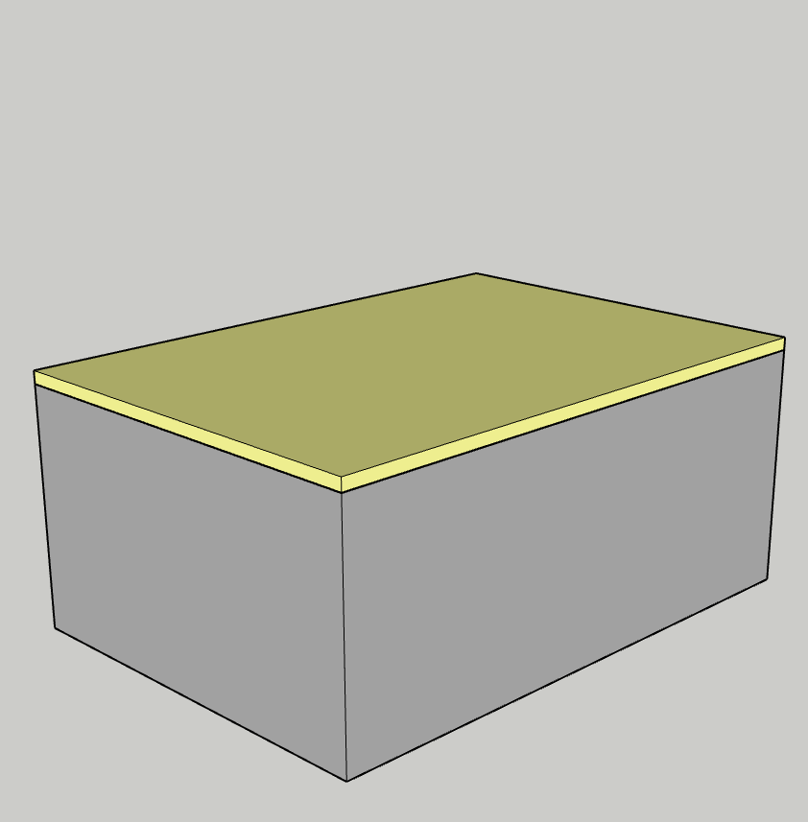
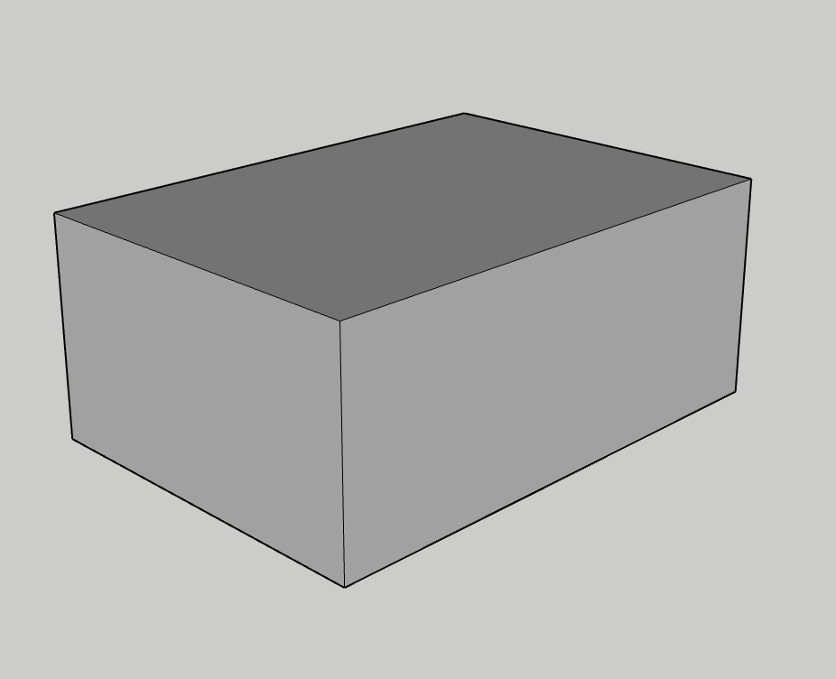
Shallow Trench Isolation (STI)
Mask counter: 0
Wafer cleaning
Silicon oxidation
Silicon nitride deposition
Photo-resist spinning
Mask1 exposure
STI etching
Surface cleaning
Wafer choice:
P-type:
  B doped
  Doping ~ 10¹⁵ cm⁻³
  Resistivity 25-50 Ωcm
(100) Orientation (common choice for CMOS)
  Lower crystalline defects
  Better SiO₂ properties

Slide 5
Shallow Trench Isolation (STI)
Mask counter: 0
Wafer cleaning
Silicon oxidation
Silicon nitride deposition
Photo-resist spinning
Mask1 exposure
STI etching
Resist stripping
Wafer is cleaned to remove particles, contaminants and native oxide
  E.g. 5H20:1H2O2:1NH3OH (SC1) + 6:H2O:1 H2O2:1 HCl (SC2) [RCA clean ]
The oxidation is performed by reacting H2O or O2 with the silicon surface to form SiO2 (temperatures are ranging around 1000 C, thickness can range from few nm to hundreds of nm)

Slide 6
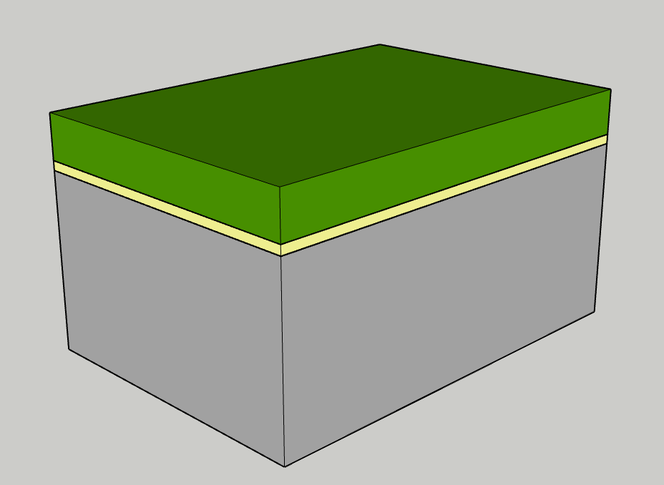
Shallow Trench Isolation (STI)
Mask counter: 0
Wafer cleaning
Silicon oxidation
Silicon nitride deposition
Photo-resist spinning
Mask1 exposure
STI etching
Resist stripping
Silicon nitride is deposited on the wafer surface by LPCVD (Low Pressure Chemical Vapor Deposition)
  3SiH₄ + 4NH₃ → Si₃N₄ + 12H₂
  T~800 C
  Thickness from tens of to hundreds of nm

Slide 7
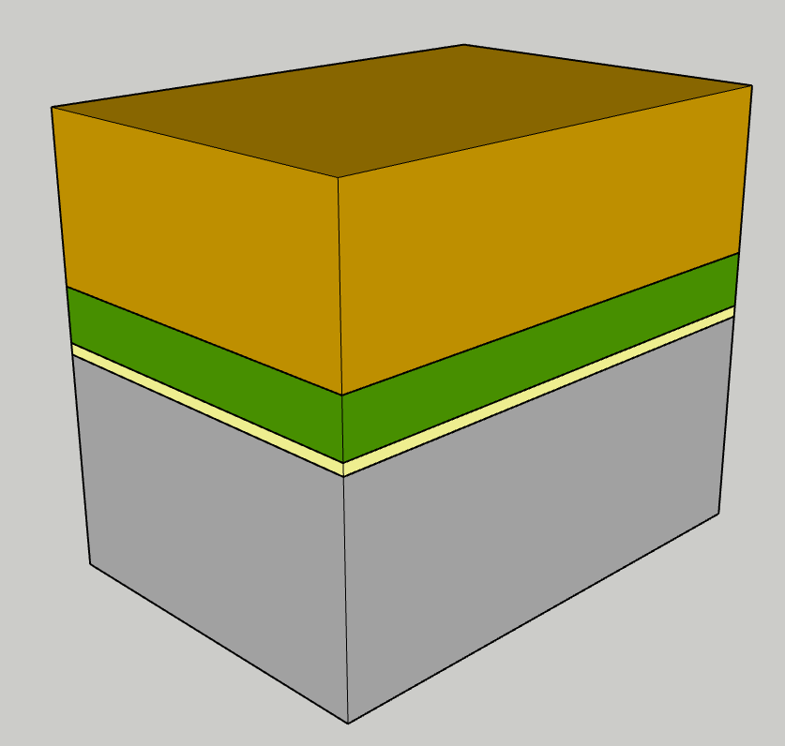
Shallow Trench Isolation (STI)
Mask counter: 0
Wafer cleaning
Silicon oxidation
Silicon nitride deposition
Photo-resist spinning
Mask1 exposure
STI etching
Resist stripping
Resist (photo sensitive resin diluted in a solvent) is deposited by spin/coating (thickness 0.1 to 5 um)
Solvent is evaporated by sitting the wafer on a hot plate (100 C, ~60 s)

Slide 8
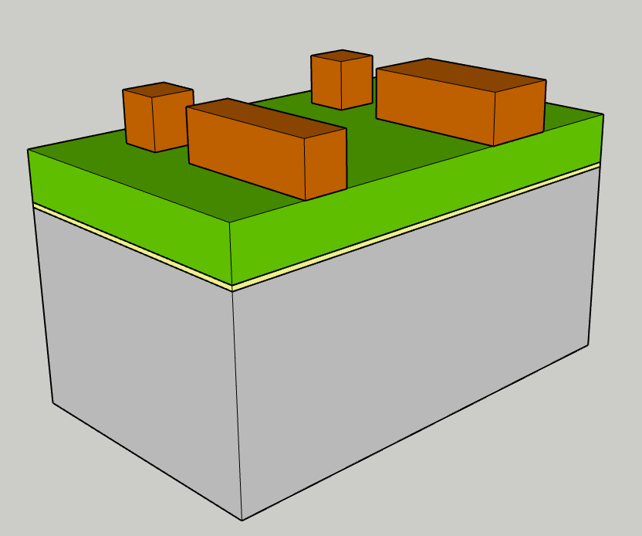
Shallow Trench Isolation (STI)
Mask counter: 1
Wafer cleaning
Silicon oxidation
Silicon nitride deposition
Photo-resist spinning
Mask1 exposure
STI etching
Resist stripping
Mask1 (active area) is exposed
Photo resist is developed: the portion exposed to light becomes soluble in a basic solution (e.g. TMAH)

Slide 9
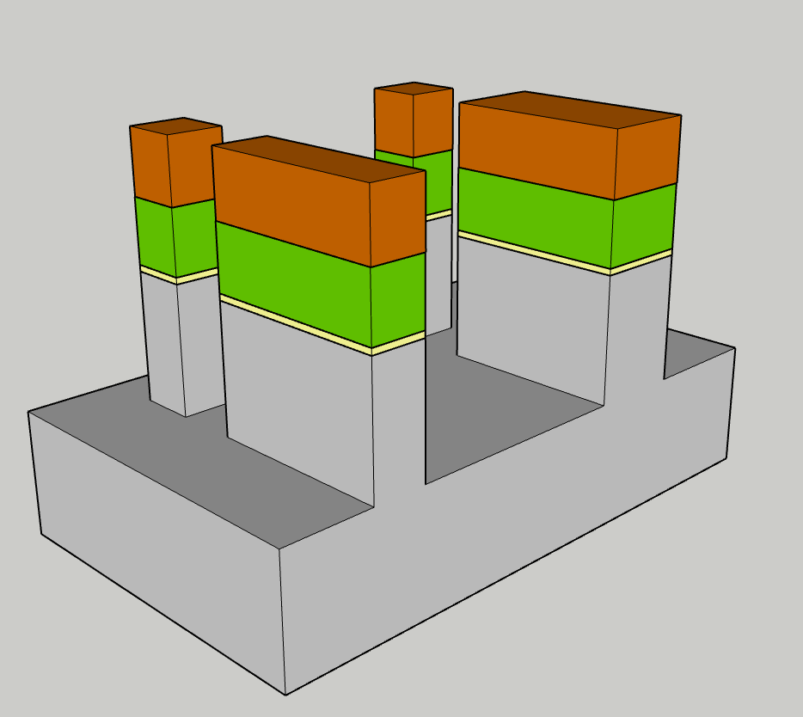
Shallow Trench Isolation (STI)
Mask counter: 1
Photo-resist spinning
Mask1 exposure
STI etching
Resist sitripping
Surface cleaning
Sidewall Oxidation
Trench filling
Silicon nitride, pad oxide and silicon are etched:
  Anisotropic plasma etching (dry etching) coupling ion sputtering and chemical etching
  Trench depth: ~hundreds of nm
  Trench sidewall can be tapered for an easier oxide filling and to reduce stress during subsequent thermal budget
The un-etched regions will become the active areas of our MOS devices
The trenches will be filled with dielctric to provide electrical insulation between adjacent source and drain regions

Slide 10
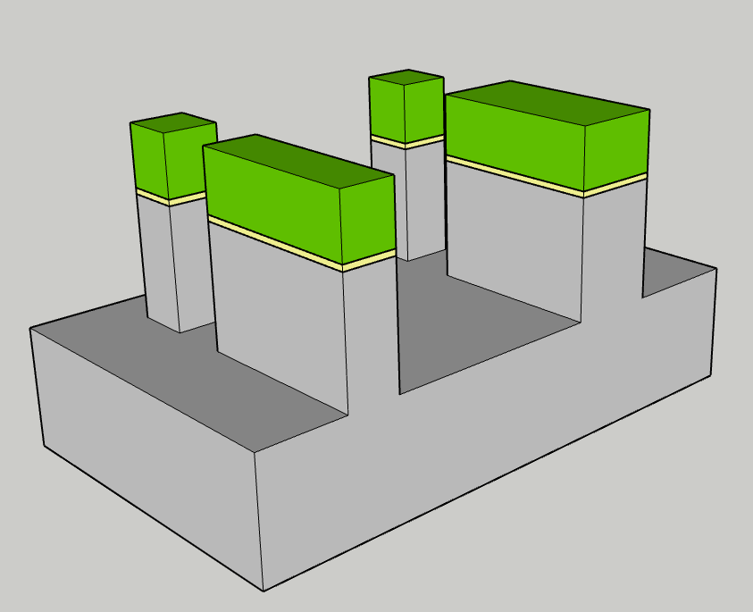
Shallow Trench Isolation (STI)
Mask counter: 1
Photo-resist spinning
Mask1 exposure
STI etching
Resist stripping
Surface cleaning
Sidewall Oxidation
Trench filling
Photo-resist is removed:
  O2 downstream plasma (no ion bombardment)
  Wet etching (e.g. H2SO4+H2O)

Slide 11
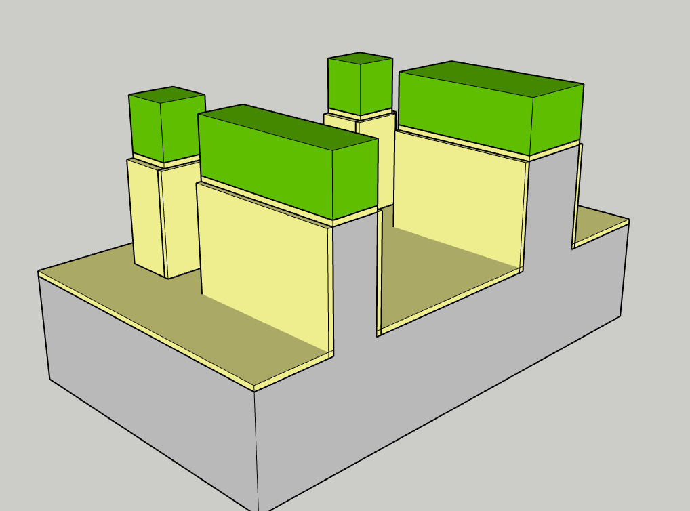
Shallow Trench Isolation (STI)
Mask counter: 1
Photo-resist spinning
Mask1 exposure
STI etching
Resist stripping
Surface cleaning
Sidewall Oxidation
Trench filling
Etch non-volatile by-products are removed from the surface (e.g. HF*H2O)
Trench sidewalls are oxidized to repair surface etch damage:
  Thickness ranging from sofractions to tenths of nm

Slide 12
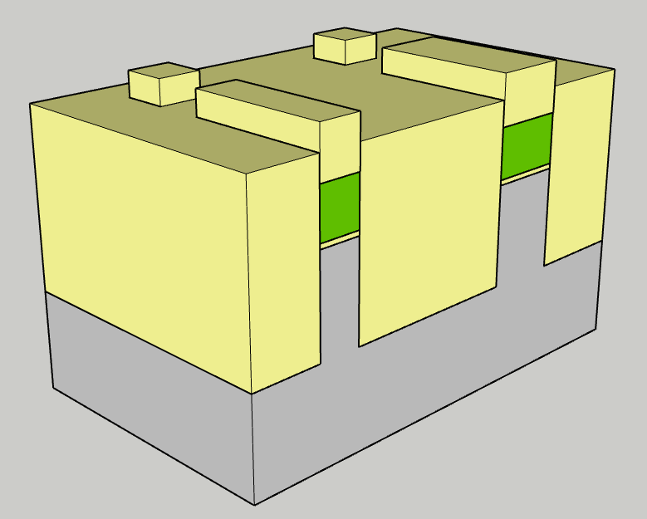
Shallow Trench Isolation (STI)
Mask counter: 1
Surface cleaning
Sidewall Oxidation
Trench filling
CMP
Field oxide lowering
Nitride stripping
Photo-resist spinning
SiO2 is deposited into the trenches. Most used techniques are:
  HDP-CVD
  ALD
  Spin coating

Slide 13
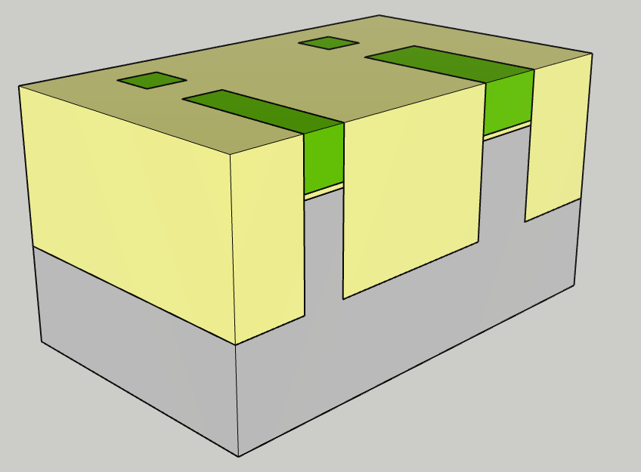
Shallow Trench Isolation (STI)
Mask counter: 1
Surface cleaning
Sidewall Oxidation
Trench filling
CMP
Field oxide lowering
Nitride stripping
Photo-resist spinning
Excess oxide is planarized by Chemical Mechanical Polishing (CMP):
  An abrasive disc and a colloidal sloution of silica or ceria particles (slurry) is used to erode silicon oxide
  CMP stops selectively on silicon nitride

Slide 14
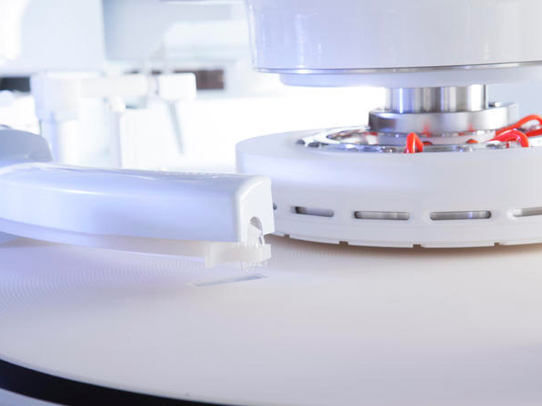
Shallow Trench Isolation (STI)
Mask counter: 1
Surface cleaning
Sidewall Oxidation
Trench filling
CMP
Field oxide lowering
Nitride stripping
Photo-resist spinning
Excess oxide is planarized by Chemical Mechanical Polishing (CMP):
  An abrasive disc and a colloidal sloution of silica or ceria particles (slurry) is used to erode silicon oxide
  CMP stops selectively on silicon nitride
Reflexion LK Prime CMP (appliedmaterials.com)

Slide 15
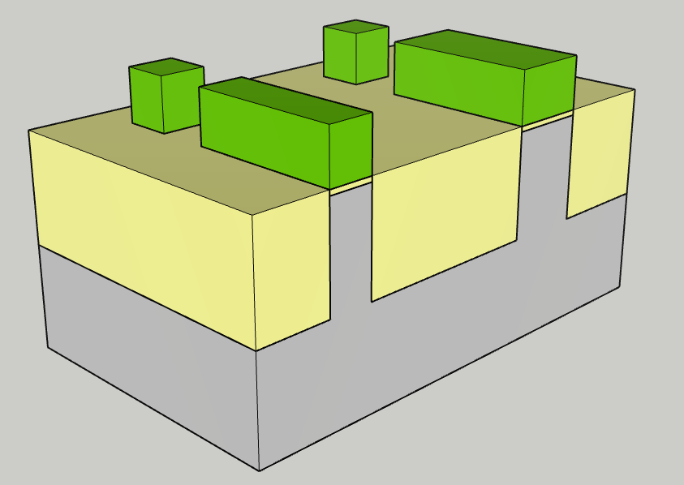
Shallow Trench Isolation (STI)
Mask counter: 1
Surface cleaning
Sidewall Oxidation
Trench filling
CMP
Field oxide lowering
Nitride stripping
Photo-resist spinning
Wet etch (e.g. HF+H2O) is used to recess silcion oxide slectively to silicon nitride.

Slide 16
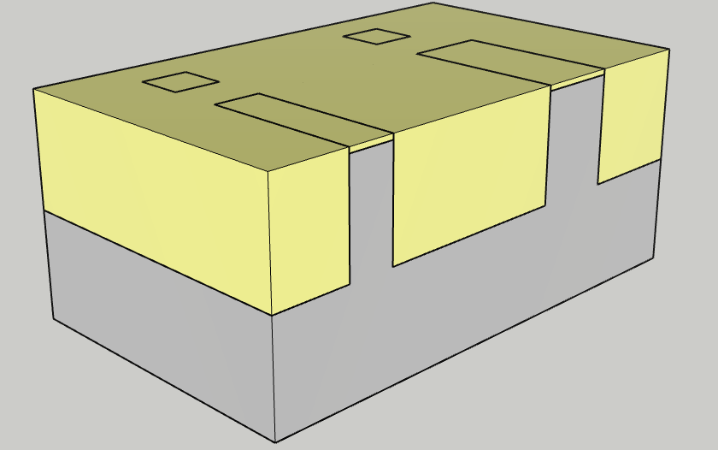
Shallow Trench Isolation (STI)
Mask counter: 1
CMP
Field oxide lowering
Nitride stripping
Photo-resist spinning
Mask 2 exposure (p-well)
Boron ion implantation
Photo resist stripping
Silicon nitride is removed by wet etching, selectively to silicon oxide
  H3P04+H2O
Planarity is restored

Slide 17
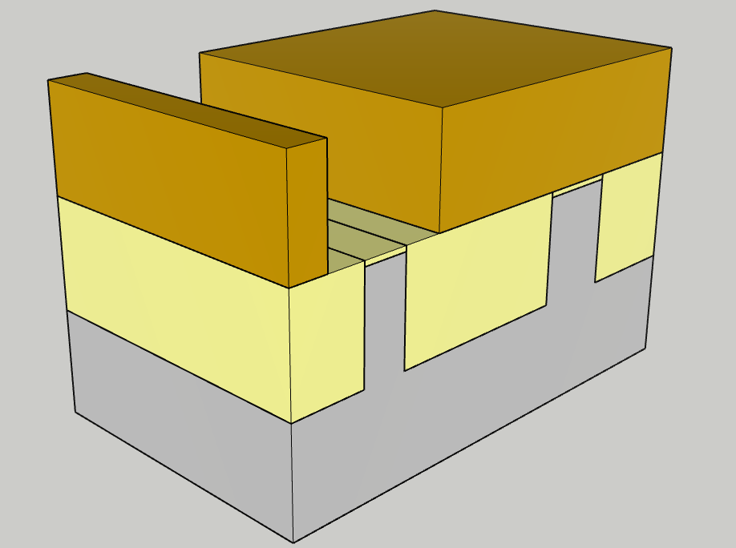
P-well
Mask counter: 2
CMP
Field oxide lowering
Nitride stripping
Photo-resist spinning
Mask 2 exposure (p-well)
Boron ion implantation
Photo resist stripping
After exposure, photoresist covers future p-channel zones
Future n-channel zones are left open

Slide 18
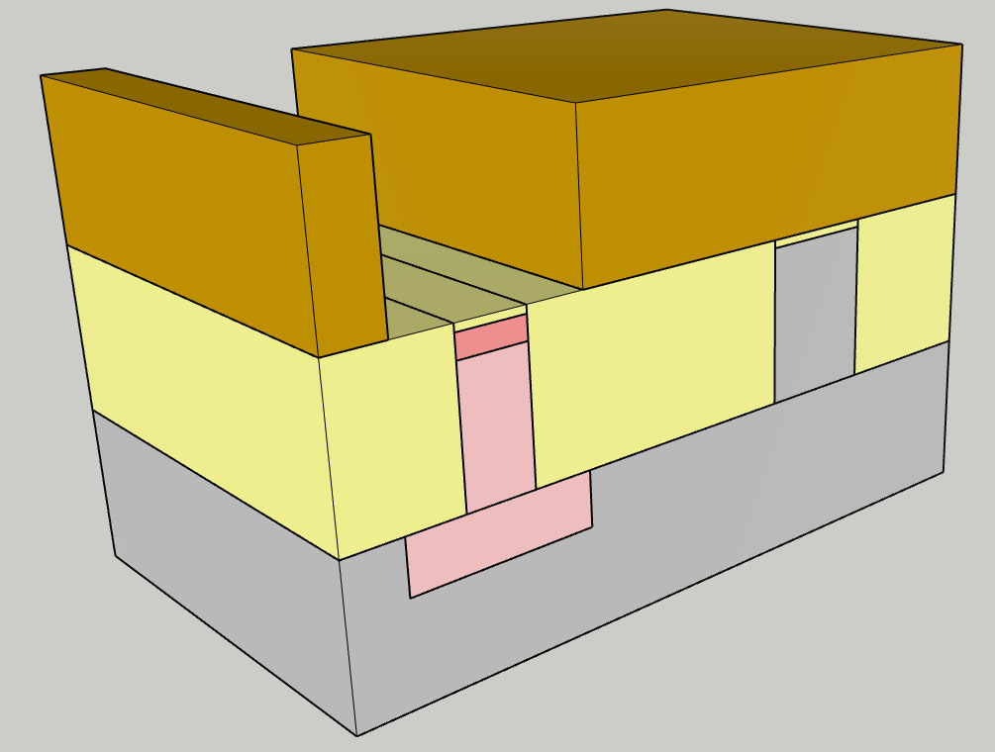
P-well
Mask counter: 2
CMP
Field oxide lowering
Nitride stripping
Photo-resist spinning
Mask 2 exposure (p-well)
Boron ion implantation
Photo resist stripping
The open areas are doped by boron implantation
  A deeper implant (hundres of KeV, lower dose) provides teh desired body doping
  A shallower implant (tens of KeV, higher dose) can be sued to tailor the transistotr threshold voltage

Slide 19
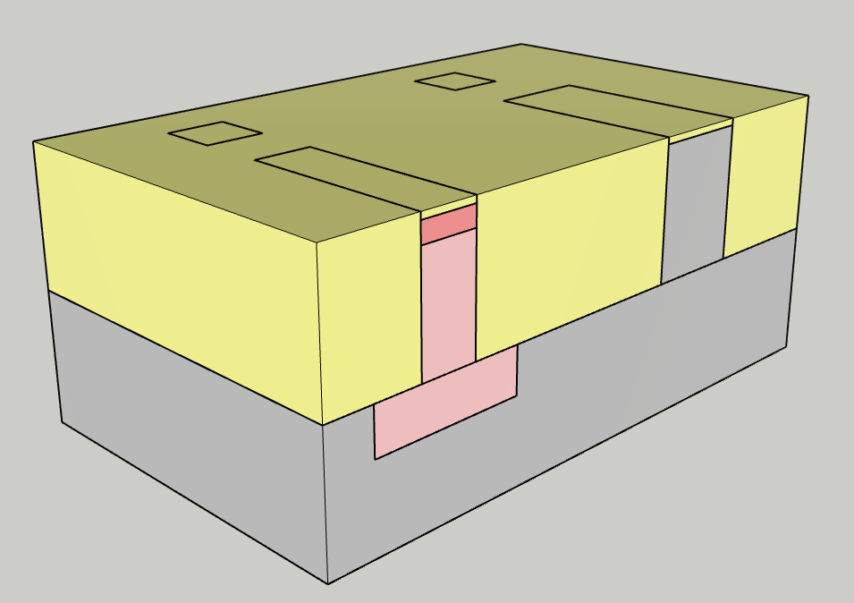
P-well
Mask counter: 2
CMP
Field oxide lowering
Nitride stripping
Photo-resist spinning
Mask 2 exposure (p-well)
Boron ion implantation
Photo resist stripping
Photo-resist is removed:
  O2 downstream plasma (no ion bombardment)
  Wet etching (e.g. H2SO4+H2O)

Slide 20
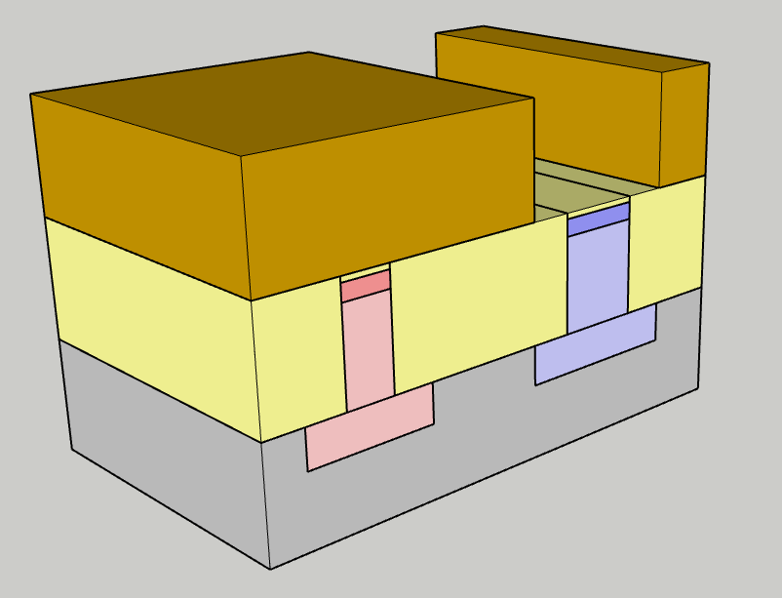
n-well
Mask counter: 3
Boron ion implantation
Photo resist stripping
Photo resist spinning
Mask 3 exposure (n-well)
Phosphorus ion implantation
Photo resist stripping
Activation annealing
After exposure, photoresist covers future n-channel zones
Future p-channel zones are left open
The open areas are doped by phosporus implantation
  A deeper implant (hundres of KeV, lower dose) provides teh desired body doping
  A shallower implant (tens of KeV, higher dose) can be sued to tailor the transistotr threshold voltage

Slide 21
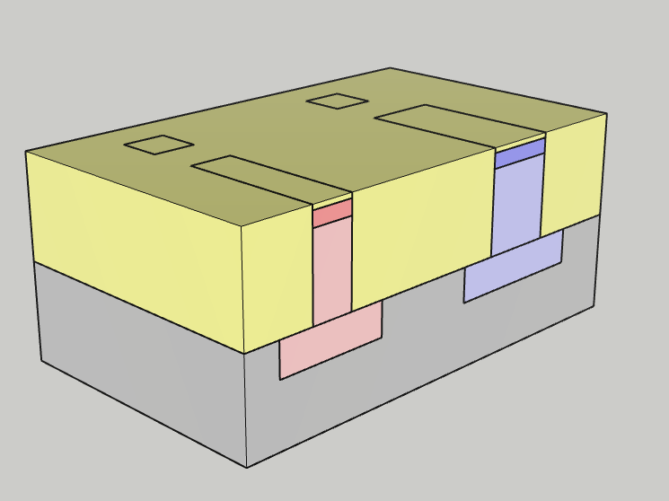
n-well
Mask counter: 3
Mask 3 exposure (n-well)
Phosphorus ion implantation
Photo resist stripping
Activation annealing
Pad oxide removal
Gate oxidation + nitridation
Gate poly-silicon deposition
Photo-resist is removed:
  O2 downstream plasma (no ion bombardment)
  Wet etching (e.g. H2SO4+H2O)
An activation anneal will ensure dopants are activated (sitting in substitutional position in the silicon lattice) and crystalline damage is repaired
  T can range around 1000 C
  Impalnted dopants will diffuse deeper

Slide 22
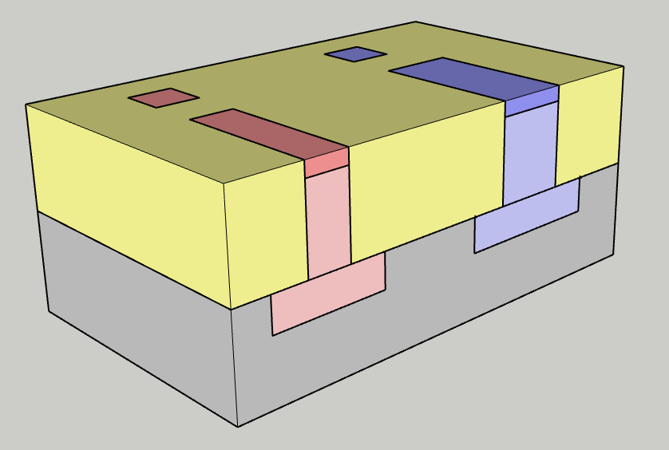
Gate formation
Mask counter: 3
Mask 3 exposure (n-well)
Phosphorus ion implantation
Photo resist stripping
Activation annealing
Pad oxide removal
Gate oxidation + nitridation
Gate poly-silicon deposition
Metallic contaminants from implanters might have been blocked by pad oxide
Pad oxide is wet etched(e.g. HF + H2O2) to prepare the silicon surface to gate oxidation

Slide 23
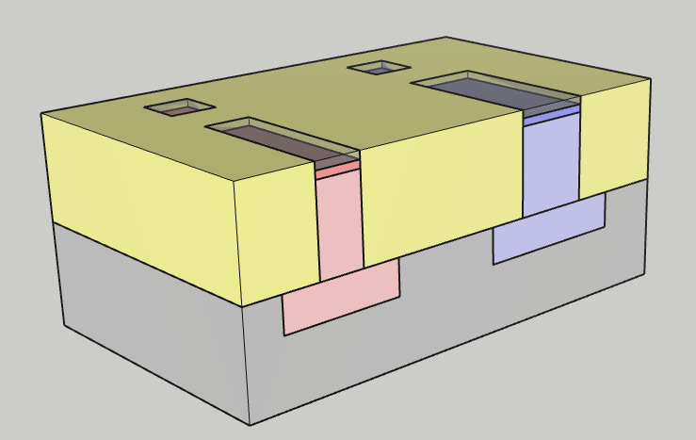
Gate formation
Mask counter: 3
Activation annealing
Pad oxide removal
Gate oxidation + nitridation
Gate poly-silicon deposition
Photo-resist spinning
Mask 4 exposure (gate)
Poly-silicon dry etching
Exposed silicon is oxidized to form gate oxide
  Wet, dry, radical or plasma oxidation
  Thickness ranging from few nm to hundreds of nm depending on the transistor operating voltages
Few atomic layers of silicon nitride are grown at silicon/silicon oxide interface (e.g. by NH3 or N2O2 plasma):
  Blocks boron diffusion into silicon oxide
  Improves gate oxide reliability

Slide 24
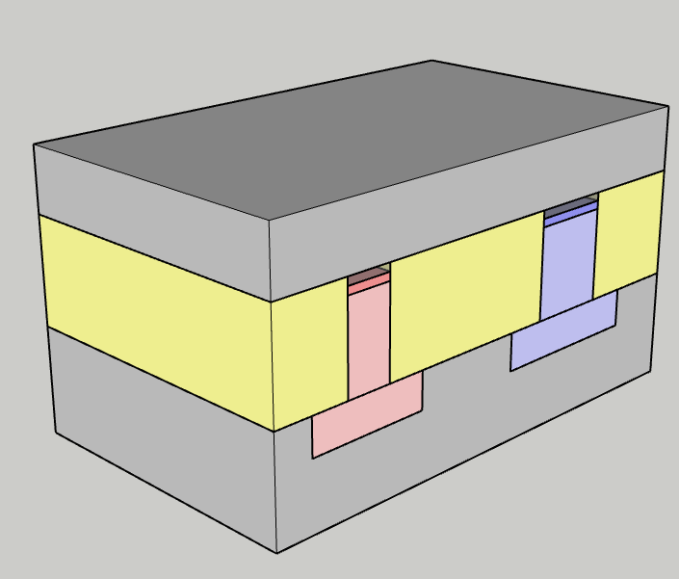
Gate formation
Mask counter: 3
Activation annealing
Pad oxide removal
Gate oxidation + nitridation
Gate poly-silicon deposition
Photo-resist spinning
Mask 4 exposure (gate)
Poly-silicon dry etching
Gate electrode material is deposited
  Poly-cristalline silicon
  Ususally deposited by LP-CVD (e.g. SiH4→ Si + 2H2)
  Thickness in the range of few hundreds of nm
  Grain texture control can be important for transitor reliability

Slide 25
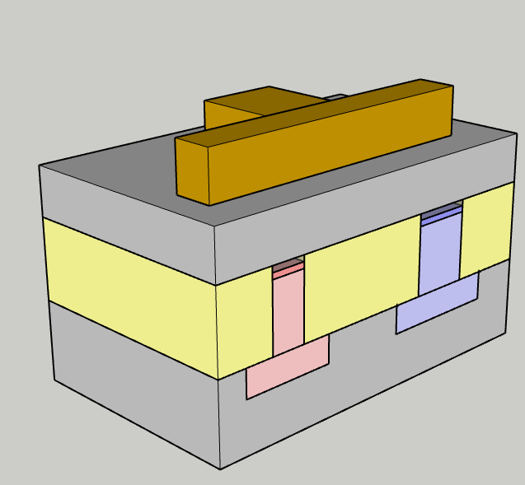
Gate formation
Mask counter: 4
Activation annealing
Pad oxide removal
Gate oxidation + nitridation
Gate poly-silicon deposition
Photo-resist spinning
Mask 4 exposure (gate)
Poly-silicon dry etching
Gate mask is exposed

Slide 26
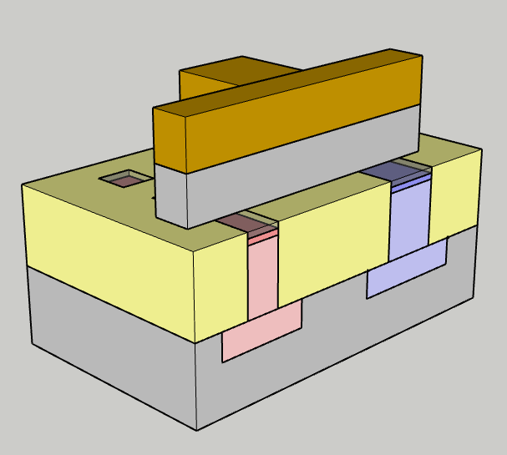
Gate formation
Mask counter: 4
Photo-resist spinning
Mask 4 exposure (gate)
Poly-silicon dry etching
Resist stripping
Photo-resist spinning
Mask 5 exposure (n LDD)
n-LDD implant
Gate is patterned by dry etching:
  Anysotropy is needed to proive dimensional contro and vertical profile
  High slectivity o the underlying gate oxide might be required

Slide 27
Gate formation
Mask counter: 4
Photo-resist spinning
Mask 4 exposure (gate)
Poly-silicon dry etching
Resist stripping
Photo-resist spinning
Mask 5 exposure (n LDD)
n-LDD implant
Photo-resist is removed:
  O2 downstream plasma (no ion bombardment)
  Wet etching (e.g. H2SO4+H2O)
Surface and sidewall cleaning might be performed

Slide 28
LDD: Lightly doped drain (graded junctions)
Mask counter: 4
Operating voltages don’t scale as fast as transistors dimension:
  5V applied across a 2μm channel transistor → average E field 2.5 10⁴ Vcm⁻¹
  Same voltage across 45nm state of the art transistor → E filed ~ 1 MVcm⁻¹ !
High electric fields in the channel:
Hot electons/holes (impact ionization, gate charge injection)
Short channel effects
Low junction doping is needed
Shallow junctions are also needed to avoid short channel effects and to reduce junction capacitance
But junctions must also be sufficiently doped to guarantee ohmic contacts to source and drain and deep enough to withstand silicide formation and contact etch
Ligtlhy doped drain LDD approach:
Self aligned graded source and drain junctions formation

Slide 29
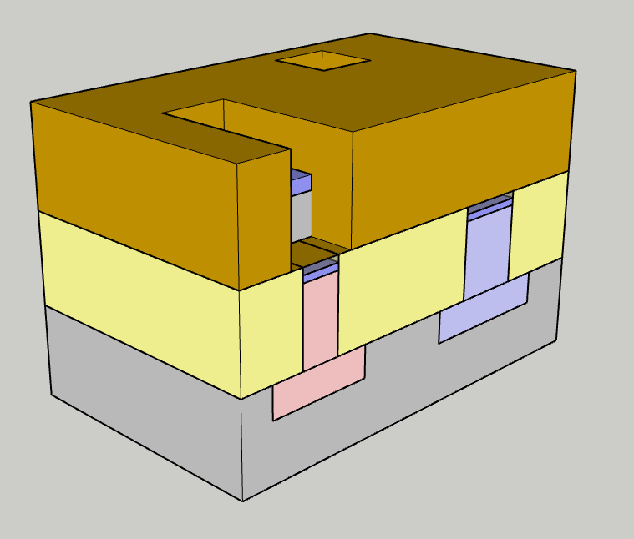
LDD: Lightly doped drain (graded junctions)
Mask counter: 5
Poly-silicon dry etching
Resist stripping
Photo-resist spinning
Mask 5 exposure (n LDD)
n-LDD implant
Resist strip
Photo-resist spinning
N-ldd mask is exposed:
Resist is removed from:
  N-channel transistor region
  N-well contact area
Shallow, low dose source and drain implant is performed:
  As or P are commonly used

Slide 30
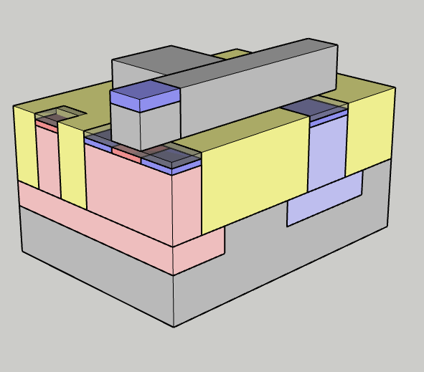
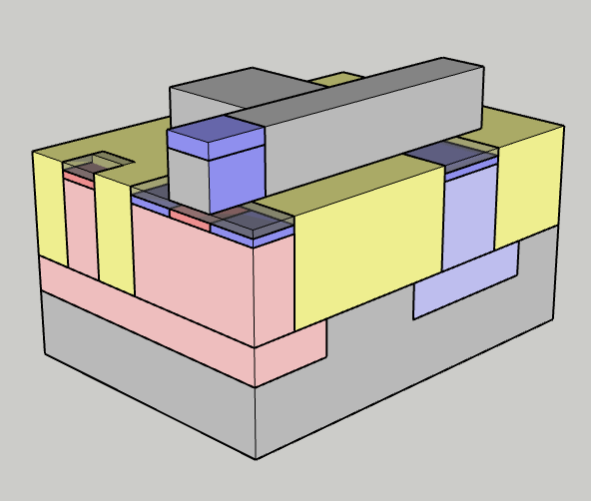
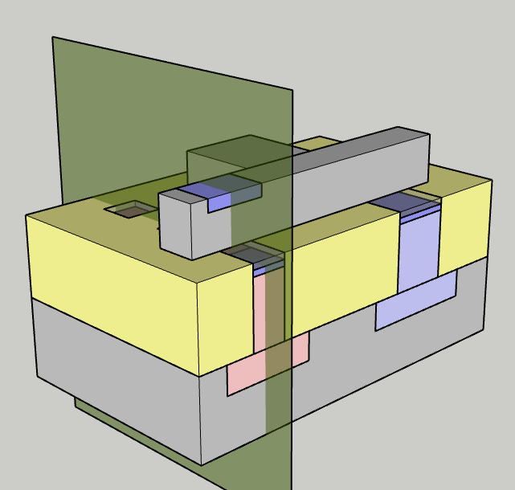
LDD: Lightly doped drain (graded junctions)
Mask counter: 5
Poly-silicon dry etching
Resist stripping
Photo-resist spinning
Mask 5 exposure (n LDD)
n-LDD implant
Resist strip
Photo-resist spinning
N-channel transistor cross section will also be displayed from now on

Slide 31
LDD: Lightly doped drain (graded junctions)
Mask counter: 5
Poly-silicon dry etching
Resist stripping
Photo-resist spinning
Mask 5 exposure (n LDD)
n-LDD implant
Resist strip
Photo-resist spinning
Photo-resist is removed:
  O2 downstream plasma (no ion bombardment)
  Wet etching (e.g. H2SO4+H2O)
Note that n-dopants are also doping the gate poly-silicon

Slide 32
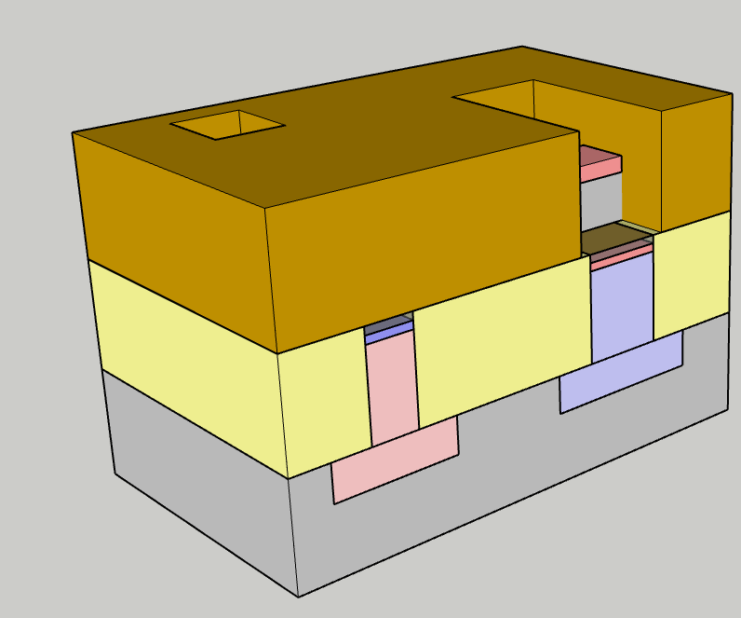
LDD: Lightly doped drain (graded junctions)
Mask counter: 6
n-LDD implant
Resist strip
Photo-resist spinning
Mask 6 exposure (p-LDD)
p-LDD implant
Resist stripping
Spacer dielectric deposition
p-ldd mask is exposed:
Resist is removed from:
  p-channel transistor region
  p-well contact area
Shallow, low dose source and drain implant is performed:
  B and In are commonly used

Slide 33
LDD: Lightly doped drain (graded junctions)
Mask counter: 6
n-LDD implant
Resist strip
Photo-resist spinning
Mask 6 exposure (p-LDD)
p-LDD implant
Resist stripping
Spacer dielectric deposition
Both n-channel and p-channel transistor cross sections will also be displayed from now on

Slide 34
LDD: Lightly doped drain (graded junctions)
Mask counter: 6
n-LDD implant
Resist strip
Photo-resist spinning
Mask 6 exposure (p-LDD)
p-LDD implant
Resist stripping
Spacer dielectric deposition
Photo-resist is removed:
  O2 downstream plasma (no ion bombardment)
  Wet etching (e.g. H2SO4+H2O)
Note that p-dopants are also doping the gate poly-silicon

Slide 35
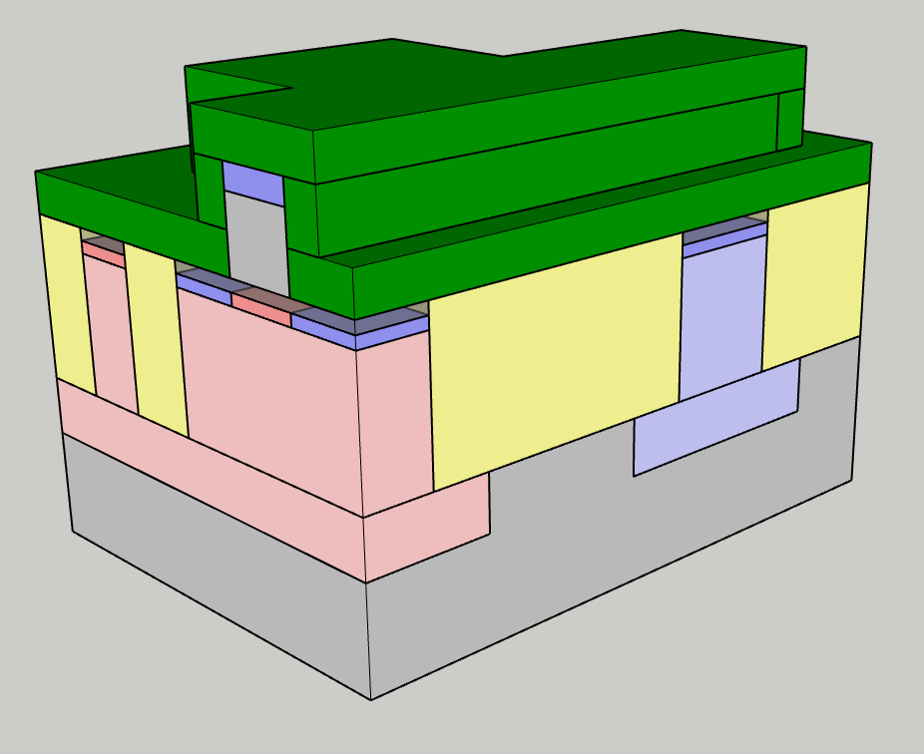
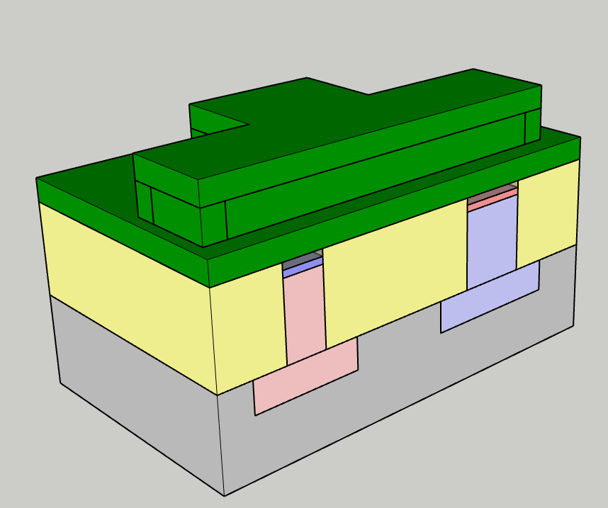
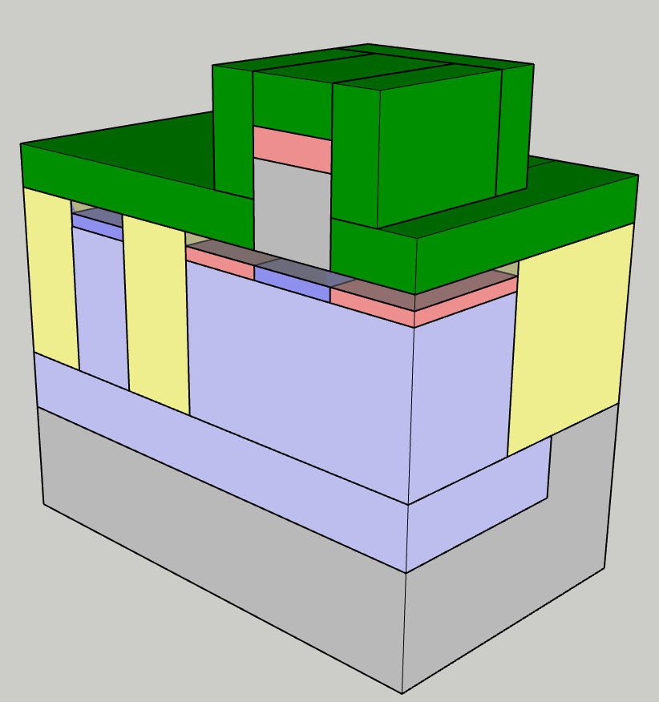
LDD: Lightly doped drain (graded junctions)
Mask counter: 6
p-LDD implant
Resist stripping
Spacer dielectric deposition
Spacer dry etching
Photo resist spinning
Mask 7 exposure (n+)
N+ implant
  LPCVD oxide or nitride are deposited
    E.g. 3SiH₄ + 4NH3 → Si3N4 +12H₂ @ about 400 °C
  The layer must be conformal: same thickness for every orientation (CVD or ALD deposition)

Slide 36
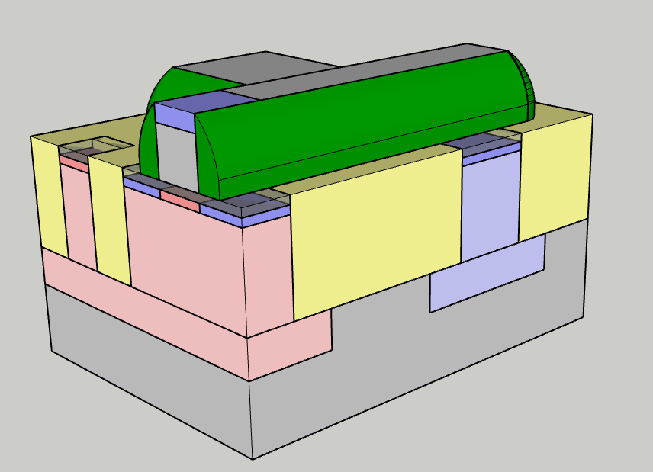
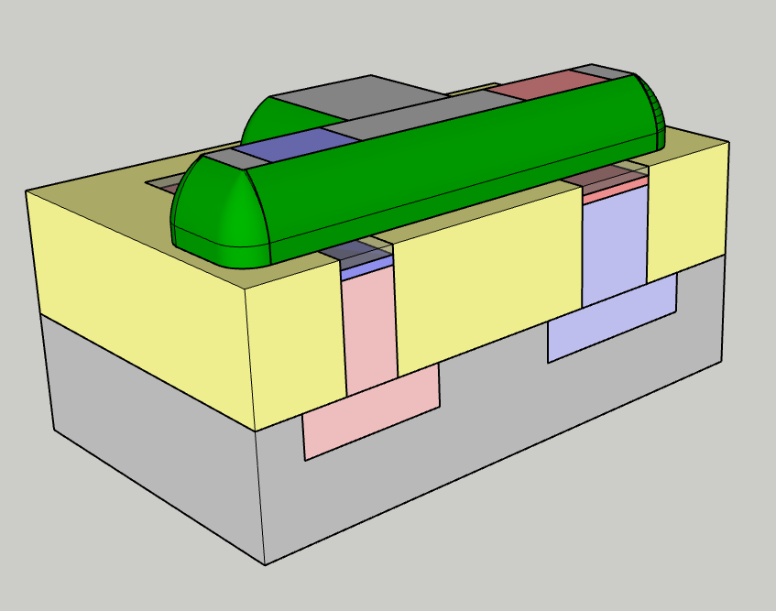
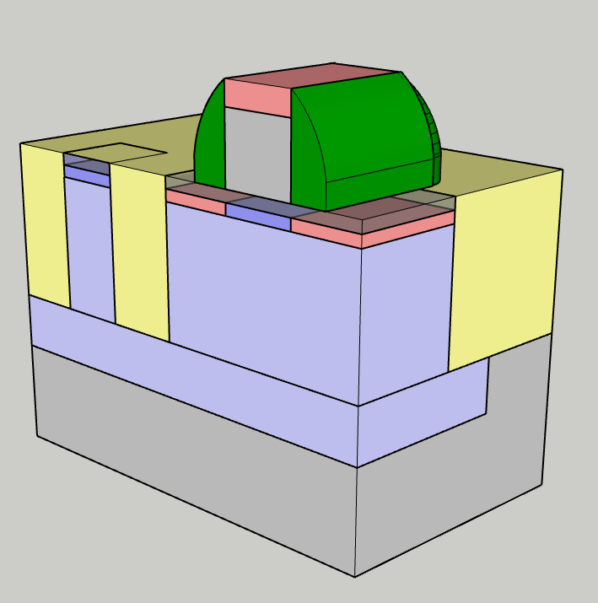
LDD: Lightly doped drain (graded junctions)
Mask counter: 6
p-LDD implant
Resist stripping
Spacer dielectric deposition
Spacer dry etching
Photo resist spinning
Mask 7 exposure (n+)
N+ implant
Spacer etching:
  Very anisotropic dry etching
  Since the etching proceeds only in the vertical direction, spacers are left on gate sidewalls.
  If nitride is used, selectivity to the underlying oxide could be required
Spacers will be used to mask, in a self-aligned fashion, LDD areas from subsequent high dose/energy implants

Slide 37
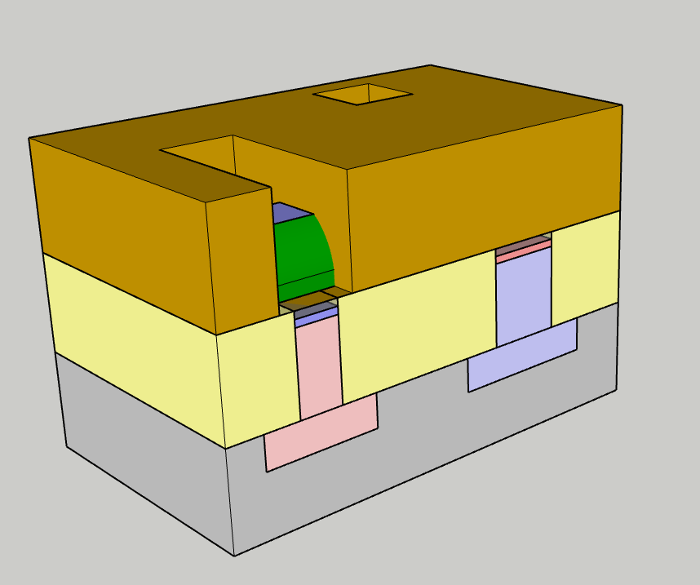
LDD: Lightly doped drain (graded junctions)
Mask counter: 7
Spacer dielectric deposition
Spacer dry etching
Photo resist spinning
Mask 7 exposure (n+)
N+ implant
Resist stripping
Photo resist spinning
N+ mask is exposed:
Resist is removed from:
  N-channel transistor region
  N-well contact area

Slide 38
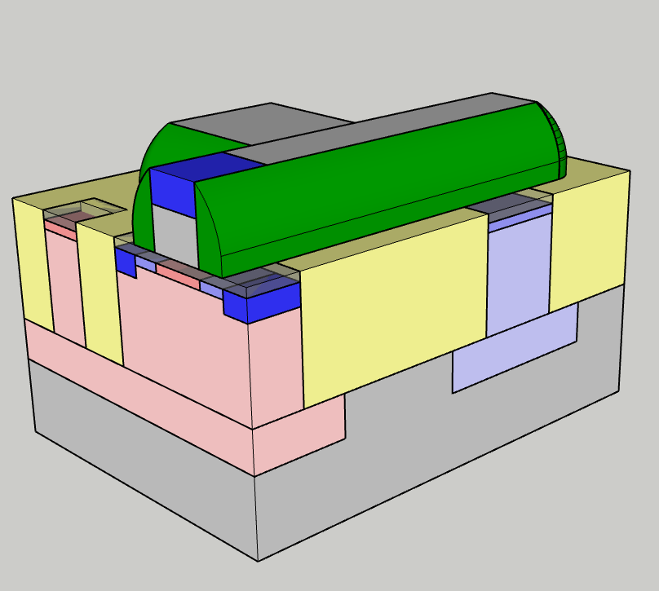
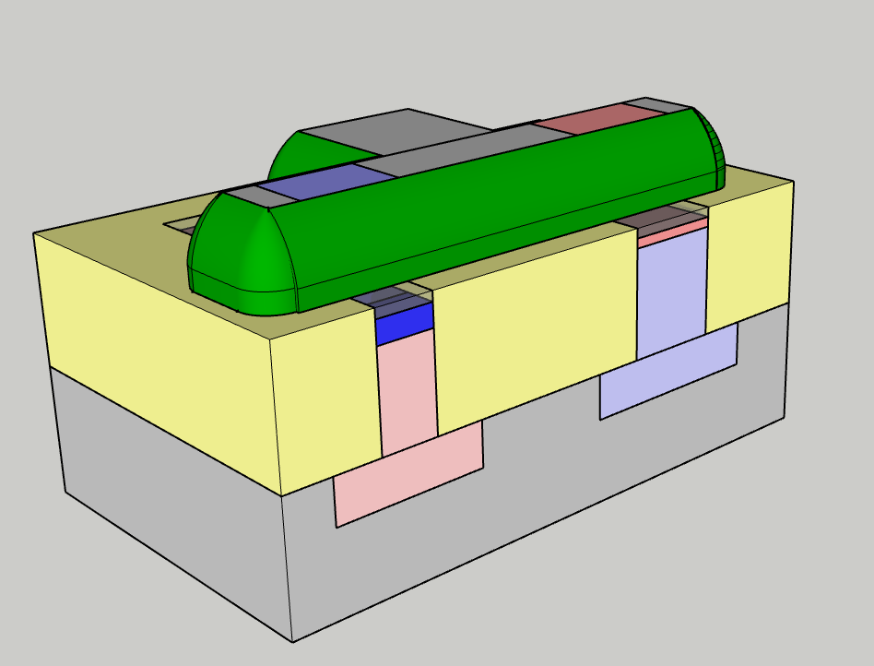
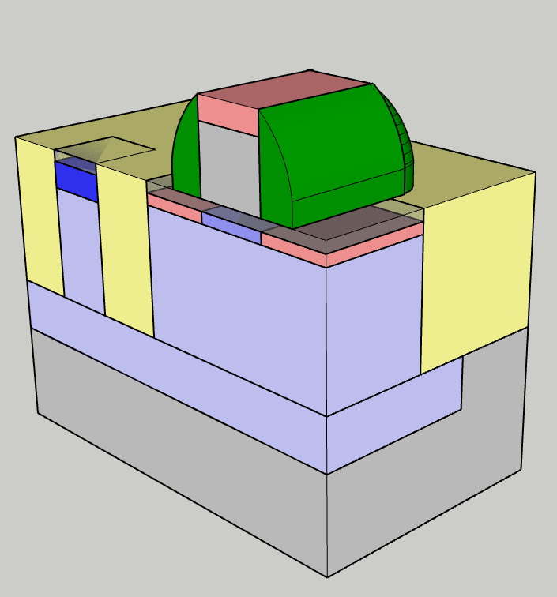
LDD: Lightly doped drain (graded junctions)
Mask counter: 7
Spacer dielectric deposition
Spacer dry etching
Photo resist spinning
Mask 7 exposure (n+)
N+ implant
Resist stripping
Photo resist spinning
Deeper, higher dose source and drain implant are performed:
  As or P are commonly used
  Spacers will mask LDD zones at the sides of the gate from additional implantation
  Polysilicon gate is exposed to implant as well

Slide 39
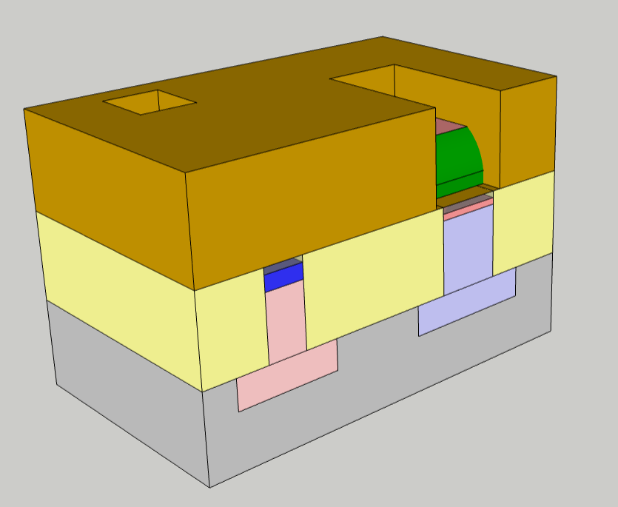
LDD: Lightly doped drain (graded junctions)
Mask counter: 8
N+ implant
Resist stripping
Photo resist spinning
Mask 8 exposure (p+)
p+ implant
Resist stripping
Dopant activation annealing
p+ mask is exposed:
Resist is removed from:
  p-channel transistor region
  p-well contact area

Slide 40
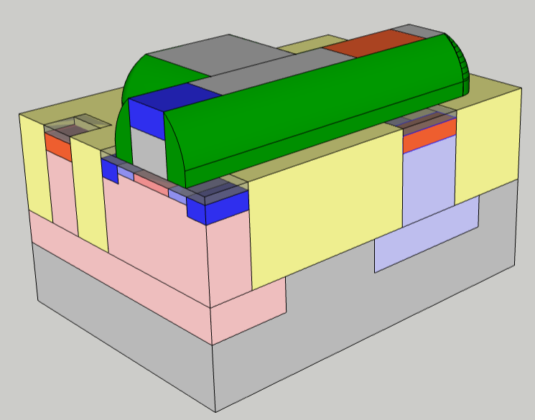
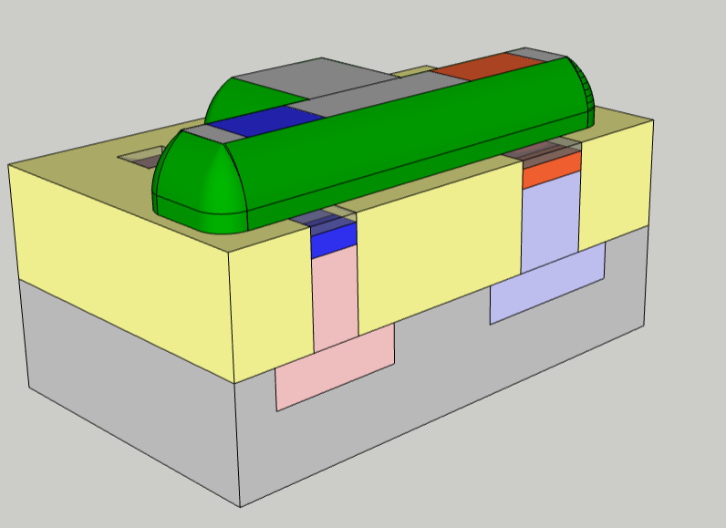
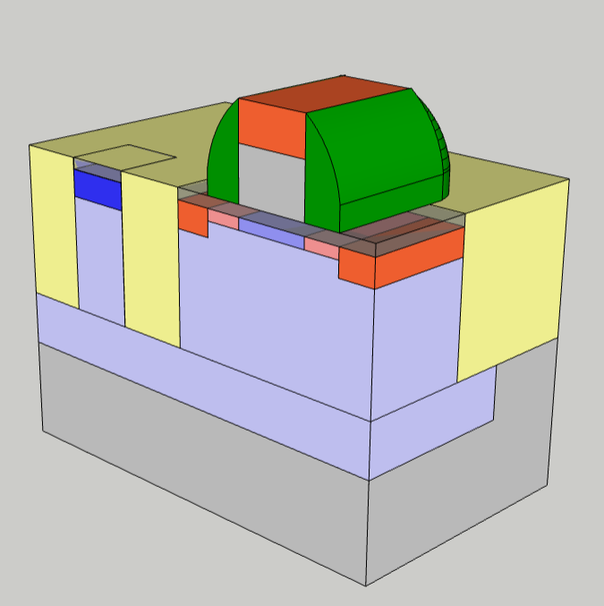
LDD: Lightly doped drain (graded junctions)
Mask counter: 8
N+ implant
Resist stripping
Photo resist spinning
Mask 8 exposure (p+)
p+ implant
Resist stripping
Dopant activation annealing
Deeper, higher dose source and drain implant are performed:
  B is commonly used
  Spacers will mask LDD zones at the sides of the gate from additional implantation
  Polysilicon gate is exposed to implant as well

Slide 41
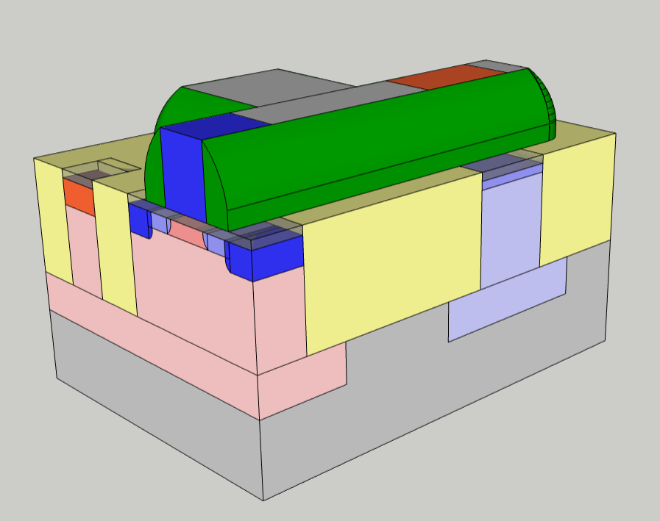



LDD: Lightly doped drain (graded junctions)
Mask counter: 8
p+ implant
Resist stripping
Dopant activation annealing
Gate oxide removal
Ti deposition
Ti RTP
Ti strip
Rapid thermal treatements are used to activate teh junction dopants:
  High T (~1000 C) are needed to avoid anomaous diffusion effects (TED, transient enhanced diffusion)
  Annealing times must be very short to avoid excessive diffusion
  Common techniques are RTP (rapid thermal process), Spike or Flash anneal, Laser anneal.
Dopants will diffuse (in both the channel region and the gate electrode)

Slide 42
LDD: Lightly doped drain (graded junctions)
Mask counter: 8
p+ implant
Resist stripping
Dopant activation annealing
Gate oxide removal
Ti deposition
Ti RTP
Ti strip
Rapid thermal treatements are used to activate teh junction dopants:
  High T (~1000 C) are needed to avoid anomaous diffusion effects (TED, transient enhanced diffusion)
  Annealing times must be very short to avoid excessive diffusion
  Common techniques are RTP (rapid thermal process), Spike or Flash anneal, Laser anneal.
Dopants will diffuse (in both the channel region and the gate electrode)

Slide 43
Local interconnections
Mask counter: 8
p+ implant
Resist stripping
Dopant activation annealing
Gate oxide removal
Ti deposition
Ti RTP
Ti strip
Exposed tunnel oxied is remove by wet etching:
  Metallic contaminants from ion implantation are removed
  Silicon is exposed for subsequent silicide formation
The following process steps will grow a metal (Titanium silicide) on expsoed silicon and poly-silicon areas.
  Local interonnections sheet resistance reduction (e.g. transistor gates)
  Better interface to metallic contacts

Slide 44



Local interconnections
Mask counter: 8
p+ implant
Resist stripping
Dopant activation annealing
Gate oxide removal
Ti deposition
Ti RTP
Ti strip
Titanium is deposited by PVD (Physical Vapor Deposition):
  Room T, typical thickness is in the tenths of nm range

Slide 45


Local interconnections
Mask counter: 8
Gate oxide removal
Ti deposition
Ti RTP
Ti strip
PMD nitride deposition
PMD oxide deposition
PMD oxide CMP
A thermal treatment (RTP) is performed at ~700 C:
Ti reacts with Si on source and drain areas, poly-Si gates:
  TiSi2 is formed
  No TiSi2 formation on dielectrics

Slide 46



Local interconnections
Mask counter: 8
Gate oxide removal
Ti deposition
Ti RTP
Ti strip
PMD nitride deposition
PMD oxide deposition
PMD oxide CMP
Unreacted Ti is removed by wet etching (NH₄OH:H₂O₂:H₂O)
The chemistry is selective to TiSi2
Titanium silicide is left on active areas and gates → self aligned process (aka salicide)

Slide 47

Contacts
Mask counter: 8
Gate oxide removal
Ti deposition
Ti RTP
Ti strip
PMD nitride deposition
PMD oxide deposition
PMD oxide CMP
A conformal silicon nitride is deposited (CVD)
Will act as a stopping layer for contact etch

Slide 48

Contacts
Mask counter: 8
Ti strip
PMD nitride deposition
PMD oxide deposition
PMD oxide CMP
Photo-resist spinning
Mask 9 exposure (contact)
Contact dry etching
Pre metal dielectric (PMD) is deposited (PE-CVD SiO2) and planarized by CMP.

Slide 49

Contacts
Mask counter: 9
Ti strip
PMD nitride deposition
PMD oxide deposition
PMD oxide CMP
Photo-resist spinning
Mask 9 exposure (contact)
Contact dry etching
Resist is removed where contacts to gate and active areas will be patterned

Slide 50



Contacts
Mask counter: 9
Photo-resist spinning
Mask 9 exposure (contact)
Contact dry etching
Resist stripping
Ti/TiN barrier deposition
W deposition
Metal CMP
PMD oxide is dry etched to form contact holes
Contacts land on both slicided silicon active areas and gate electodes
The etch is composed of two steps:
  Oxide etch, selective to silicon nitride → allows for simultaneous etching of different oxide thickness n top of gates (thinner) and active areas (thicker). When the oxide on top of gates I consumed, the nitride will avoid the additional etch needed to land on active areas to damage the gate electrode.
  Nitride etch, selective to TiSi2 → safe landing on gate and active areas

Slide 51

Contacts
Mask counter: 9
Gate contact cross section
Photo-resist spinning
Mask 9 exposure (contact)
Contact dry etching
Resist stripping
Ti/TiN barrier deposition
W deposition
Metal CMP
PMD oxide is dry etched to form contact holes
Contacts land on both slicided silicon active areas and gate electodes
The etch is composed of two steps:
  Oxide etch, selective to silicon nitride → allows for simultaneous etching of different oxide thickness n top of gates (thinner) and active areas (thicker). When the oxide on top of gates I consumed, the nitride will avoid the additional etch needed to land on active areas to damage the gate electrode.
  Nitride etch, selective to TiSi2 → safe landing on gate and active areas

Slide 52



Contacts
Mask counter: 9
Photo-resist spinning
Mask 9 exposure (contact)
Contact dry etching
Resist stripping
Ti/TiN barrier deposition
W deposition
Metal CMP
Thin layers of Ti/TiN are deposited (CVD):
  Promotes W adhesion
  Since W will be deposited by WF6 (CVD) → protects silicon oxide from F etch

Slide 53



Contacts
Mask counter: 9
Photo-resist spinning
Mask 9 exposure (contact)
Contact dry etching
Resist stripping
Ti/TiN barrier deposition
W deposition
Metal CMP
Tungsten is deposited by CVD:
  WF6 → W + 3F2
Low resistance material for contacts

Slide 54



Contacts
Mask counter: 9
Photo-resist spinning
Mask 9 exposure (contact)
Contact dry etching
Resist stripping
Ti/TiN barrier deposition
W deposition
Metal CMP
Chemical mechanical polishing removes Excess W and Ti/TiN landing selectively on silicon oxide

Slide 55


Multi level metals: metal 1
Mask counter: 10
Metal CMP
TiN+Al(Cu) deposition
Photo reist spinning
Mask 10 exposure (Metal1)
Metal 1 etch
Resist strip
Surface clean
TiN + Al stack is deposited (PVD depostion)
  TiN can act a as a shunt in case of Al cracks due to electromigration induced failures
  Some Cu (few %) is usually added to Al to mitigate electromigration
Metal1 mask is exposed
Al+TiN stack is dry etched to form desired metal1 interconnections
Etch by products cleaning (wet etch) is needed to avoid metal corrosion (due to Cl2 in etch chemistry)

Slide 56



Multi level metals: vias 1
Mask counter: 11
Surface clean
IMD oxide deposition
IMD CMP
Photo resist spinning
Mask 11 exposure (Via1)
Via 1 dry etch
Resist stripping
The contacts formation process is repeated once again (contact between metal layers are called vias=)
  Inter-metal dielectric (IMD) silicon oxide is deposited and planarized by CMP
  Via 1 mask is exposed and vias are dry etched
  Ti+TiN barrier layers are deposited
  W is deposited
  W and Ti/TiN are removed by CMP stopping on IMD silicon oxide

Slide 57
Multi level metals: vias 1
Mask counter: 11
Via 1 dry etch
Resist stripping
Ti/TiN deposition
W deposition
Metal CMP
TiN + Al deposition
Photo resist spinning
The contacts formation process is repeated once again (contact between metal layers are called vias=)
  Inter-metal dielectric (IMD) silicon oxide is deposited and planarized by CMP
  Via 1 mask is exposed and vias are dry etched
  Ti+TiN barrier layers are deposited
The contacts formation process is repeated once again (contact between metal layers are called vias=)
  Inter-metal dielectric (IMD) silicon oxide is deposited and planarized by CMP
  Via 1 mask is exposed and vias are dry etched
  Ti+TiN barrier layers are deposited
  W is deposited
  W and Ti/TiN are removed by CMP stopping on IMD silicon oxide

Slide 58

Multi level metals: bonding pads
Mask counter: 12
W deposition
Metal CMP
TiN + Al deposition
Photo resist spinning
Mask 12 exposure (Bonding pads)
Bonding pad dry etch
Surface clean
Last level of metal (bonding pads) is formed (same as metal1):
  TiN + Al deposition
  Bonding pad mask exposure
  Metal dry etching
  Surface clean
Note: only two of the four needed bonding pads are shown in the pictures

Slide 59




Passivation and pad opening
Mask counter: 13
Surface clean
Passivation deposition
Resist spinning
Mask 13 exposure (passivation opening)
Passivation dry etch
Resist strip
Final alloy
A passivation layer (silicon oxide, silicon nitride or organic layers) is deposited to protect the chip during subsequent handling and act as barrier from contamination
The layer is the patterned to expose the pads for bonding
A final annealing at about 400 C, in H₂/N₂ is used to alloy metals and repair defects in active oxides

Slide 60

Some real transistors
Metal2
Vias
Metal1
Spacers
Poly-Si gate
Contacts
STI
Silicon substrate
TiSi₂

Slide 61

Some real multi-layer metals
Intel 32 nm process

